Slide 1
THE UNIFIED PROCESS
It suggests a process flow that is iterative and incremental, providing the evolutionary feel that is essential in modern software development.

Slide 2
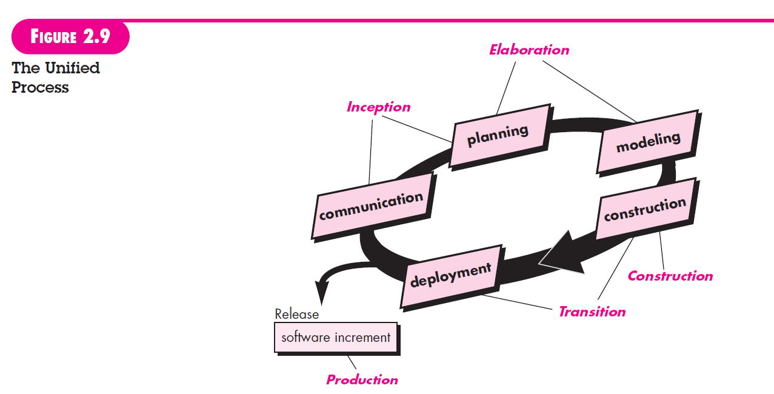
PHASES OF THE UNIFIED PROCESS

Slide 3
The INCEPTION PHASE of the UP encompasses both customer communication and planning activities.
By collaborating with stakeholders, business requirements for the software are identified; a rough architecture for the system is proposed; and a plan for the iterative, incremental nature of the ensuing project is developed.
Fundamental business requirements are described through a set of preliminary use cases that describe which features and functions each major class of users desires.
Planning identifies resources, assesses major risks, defines a schedule, and establishes a basis for the phases that are to be applied as the software increment is developed.

Slide 4
ELABORATION refines and expands the preliminary use cases that were developed as part of the inception phase and expands the architectural representation to include five different views of the software—the use case model, the requirements model, the design model, the implementation model, and the deployment model.
In addition, the plan is carefully reviewed at the culmination of the elaboration phase to ensure that scope, risks, and delivery dates remain reasonable. Modifications to the plan are often made at this time.

Slide 5
The CONSTRUCTION PHASE of the UP is identical to the construction activity defined for the generic software process.
Using the architectural model as input, the construction phase develops or acquires the software components that will make each use case operational for end users.
To accomplish this, requirements and design models that were started during the elaboration phase are completed to reflect the final version of the software increment.
All necessary and required features and functions for the software increment (i.e., the release) are then implemented in source code.
As components are being implemented, unit tests are designed and executed for each.
In addition, integration activities (component assembly and integration testing) are conducted.

Slide 6
The TRANSITION PHASE of the UP encompasses the latter stages of the generic construction activity and the first part of the generic deployment (delivery and feedback) activity.
Software is given to end users for beta testing and user feedback reports both defects and necessary changes.
In addition, the software team creates the necessary support information (e.g., user manuals, troubleshooting guides, installation procedures) that is required for the release.
At the conclusion of the transition phase, the software increment becomes a usable software release.

Slide 7
The PRODUCTION PHASE of the UP coincides with the deployment activity of the generic process.
During this phase, the ongoing use of the software is monitored, support for the operating environment (infrastructure) is provided, and defect reports and requests for changes are submitted and evaluated.

